Slide 1
Factorise and solve the following:
x² + 8x + 15 = 0
x² + 8x + 7 = 0
x² + 9x + 20 = 0
x² + 6x + 9 = 0
x² – 6x + 5 = 0
x² – 2x + 1 = 0
x² + 3x – 18 = 0
x² – 3x – 18 = 0
x² + 3x – 28 = 0
x² – x – 12 = 0
x² + 2x – 24 = 0
x² - 7x + 12 = 0
5x² + 16x + 3 = 0
2x² + 11x + 5 = 0
3x² + 4x + 1 = 0
8x² + 6x + 1 = 0
6x² + 13x + 6 = 0
6x² - 7x + 1 = 0

Slide 2
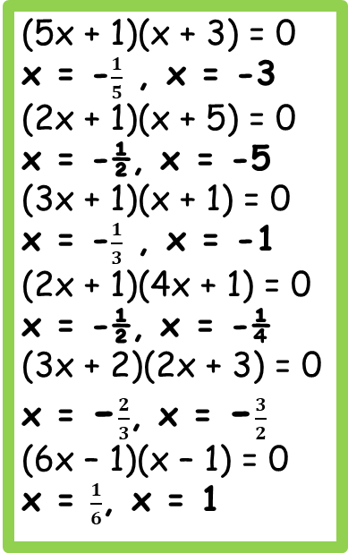
Answers
(5x + 1)(x + 3) = 0
x = -$\frac{1}{5}$ , x = -3
(2x + 1)(x + 5) = 0
x = -½, x = -5
(3x + 1)(x + 1) = 0
x = -$\frac{1}{3}$ , x = -1
(2x + 1)(4x + 1) = 0
x = -½, x = -¼
(3x + 2)(2x + 3) = 0
x = -$\frac{2}{3}$, x = -$\frac{3}{2}$
(6x – 1)(x – 1) = 0
x = $\frac{1}{6}$, x = 1
(x + 5)(x + 3) = 0
x = -5, x = -3
(x + 1)(x + 7) = 0
x = -1, x = -7
(x + 4)(x + 5) = 0
x = -4, x = -5
(x + 3)(x + 3) = 0
x = -3
(x – 5)(x – 1) = 0
x = 5, x = 1
(x – 1)(x – 1) = 0
x = 1
(x + 6)(x – 3) = 0
x = -6, x = 3
(x – 6)(x + 3) = 0
x = 6, x = -3
(x + 7)(x – 4) = 0
x = -7, x = 4
(x – 4)(x + 3) = 0
x = 4, x = -3
(x + 6)(x – 4) = 0
x = -6, x = 4
(x – 3)(x – 4) = 0
x = 3, x = 4

Slide 3
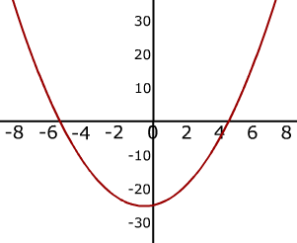
ax² + bx + c > 0
…means “for what values of x is this quadratic above the x axis”
e.g. x² + x - 20 > 0
ax² + bx + c < 0
…means “for what values of x is this quadratic below the x axis”
e.g. x² + x - 20 < 0

Slide 4
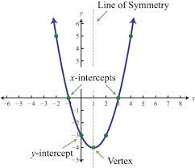
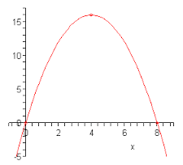
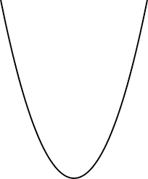
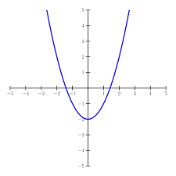
The shape of a quadratic graph is a parabola.
When we solve a quadratic equation, we are find the points where the graph intersects the x axis.

Slide 5
Start by solving the inequality as an equation
Solve x² + 6x + 8 ≤ 0
Solve x² + 6x + 8 = 0
(x + 4)(x + 2) = 0
x = -4, x = -2

Slide 6
Solve x² + 6x + 8 ≤ 0
Solve x² + 6x + 8 = 0
These are the point where the quadratic graph intersects the x axis
(x + 4)(x + 2) = 0
x = -4, x = -2

Slide 7
Solve x² + 6x + 8 ≤ 0
Solve x² + 6x + 8 = 0
(x + 4)(x + 2) = 0
x = -4, x = -2
-4
-2
Now we need to sketch the graph

Slide 8
Solve x² + 6x + 8 ≤ 0
Solve x² + 6x + 8 = 0
(x + 4)(x + 2) = 0
x = -4, x = -2
-4
-2
For what values of x is the graph below the x axis?

Slide 9
Solve x² + 6x + 8 ≤ 0
Solve x² + 6x + 8 = 0
(x + 4)(x + 2) = 0
x = -4, x = -2
-4
-2
The graph is below the x axis between
-4 and -2.
Let’s write that as an inequality…
-4 ≤ x ≤ -2

Slide 10
Solve x² + 6x + 8 ≤ 0
Solve x² + 6x + 8 = 0
(x + 4)(x + 2) = 0
x = -4, x = -2
-4
-2
Remember the graph was greater than or equal to zero
-4 ≤ x ≤ -2

Slide 11
Solve x² + 6x + 8 ≥ 0
What’s different this time?

Slide 12
Start by solving the inequality as an equation
Solve x² + 6x + 8 ≥ 0
Solve x² + 6x + 8 = 0
(x + 4)(x + 2) = 0
x = -4, x = -2

Slide 13
Solve x² + 6x + 8 ≥ 0
Solve x² + 6x + 8 = 0
These are the point where the quadratic graph intersects the x axis
(x + 4)(x + 2) = 0
x = -4, x = -2

Slide 14
Solve x² + 6x + 8 ≥ 0
Solve x² + 6x + 8 = 0
(x + 4)(x + 2) = 0
x = -4, x = -2
-4
-2
The graph is below the x axis between
-4 and -2.
Let’s write that as an inequality…
-4 ≤ x ≤ -2

Slide 15
Solve x² + 6x + 8 ≥ 0
Solve x² + 6x + 8 = 0
(x + 4)(x + 2) = 0
x = -4, x = -2
-4
-2
Now we need to sketch the graph

Slide 16
Solve x² + 6x + 8 ≥ 0
Solve x² + 6x + 8 = 0
(x + 4)(x + 2) = 0
x = -4, x = -2
-4
-2
For what values of x is the graph above the x axis?

Slide 17
Solve x² + 6x + 8 ≥ 0
Solve x² + 6x + 8 = 0
(x + 4)(x + 2) = 0
x = -4, x = -2
-4
-2
Remember the graph was greater than or equal to zero
x ≤ -4, x ≥ -2

Slide 18
Solve x² - 2x - 35 > 0
Solve x² - 2x - 35 = 0
(x - 7)(x + 5) = 0
x = 7, x = -5
-5
7
x < -5, x > 7

Slide 19
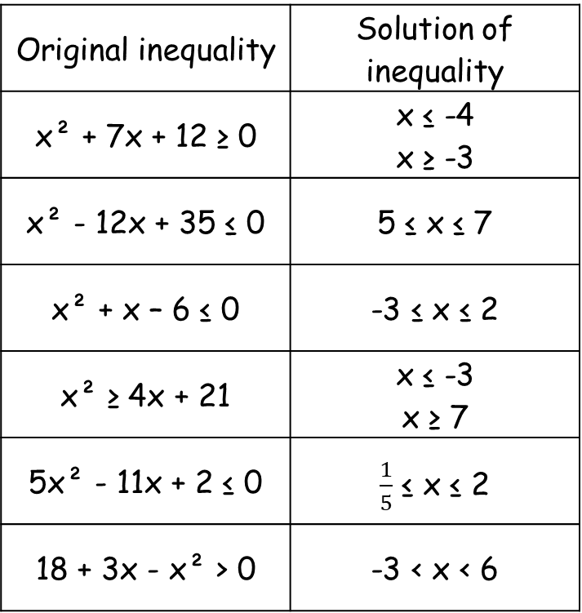
Answers
Original inequality | Solution of inequality
(x – 5)(x + 3) ≥ 0 | x ≤ -3 x ≥ 5
(x – 3)(x – 5) < 0 | 3 < x < 5
(x + 4)(x – 7) > 0 | x < -4 x > 7
x² + 10x + 21 ≥ 0 | x ≤ -7 x ≥ -3
x² + 6x + 5 > 0 | x < -5 x > -1
x² - 3x + 2 < 0 | 1 < x < 2
Original inequality | Solution of inequality
x² + 7x + 12 ≥ 0 | x ≤ -4 x ≥ -3
x² - 12x + 35 ≤ 0 | 5 ≤ x ≤ 7
x² + x – 6 ≤ 0 | -3 ≤ x ≤ 2
x² ≥ 4x + 21 | x ≤ -3 x ≥ 7
5x² - 11x + 2 ≤ 0 | $\frac{1}{5}$ ≤ x ≤ 2
18 + 3x - x² > 0 | -3 < x < 6

